Slide 1

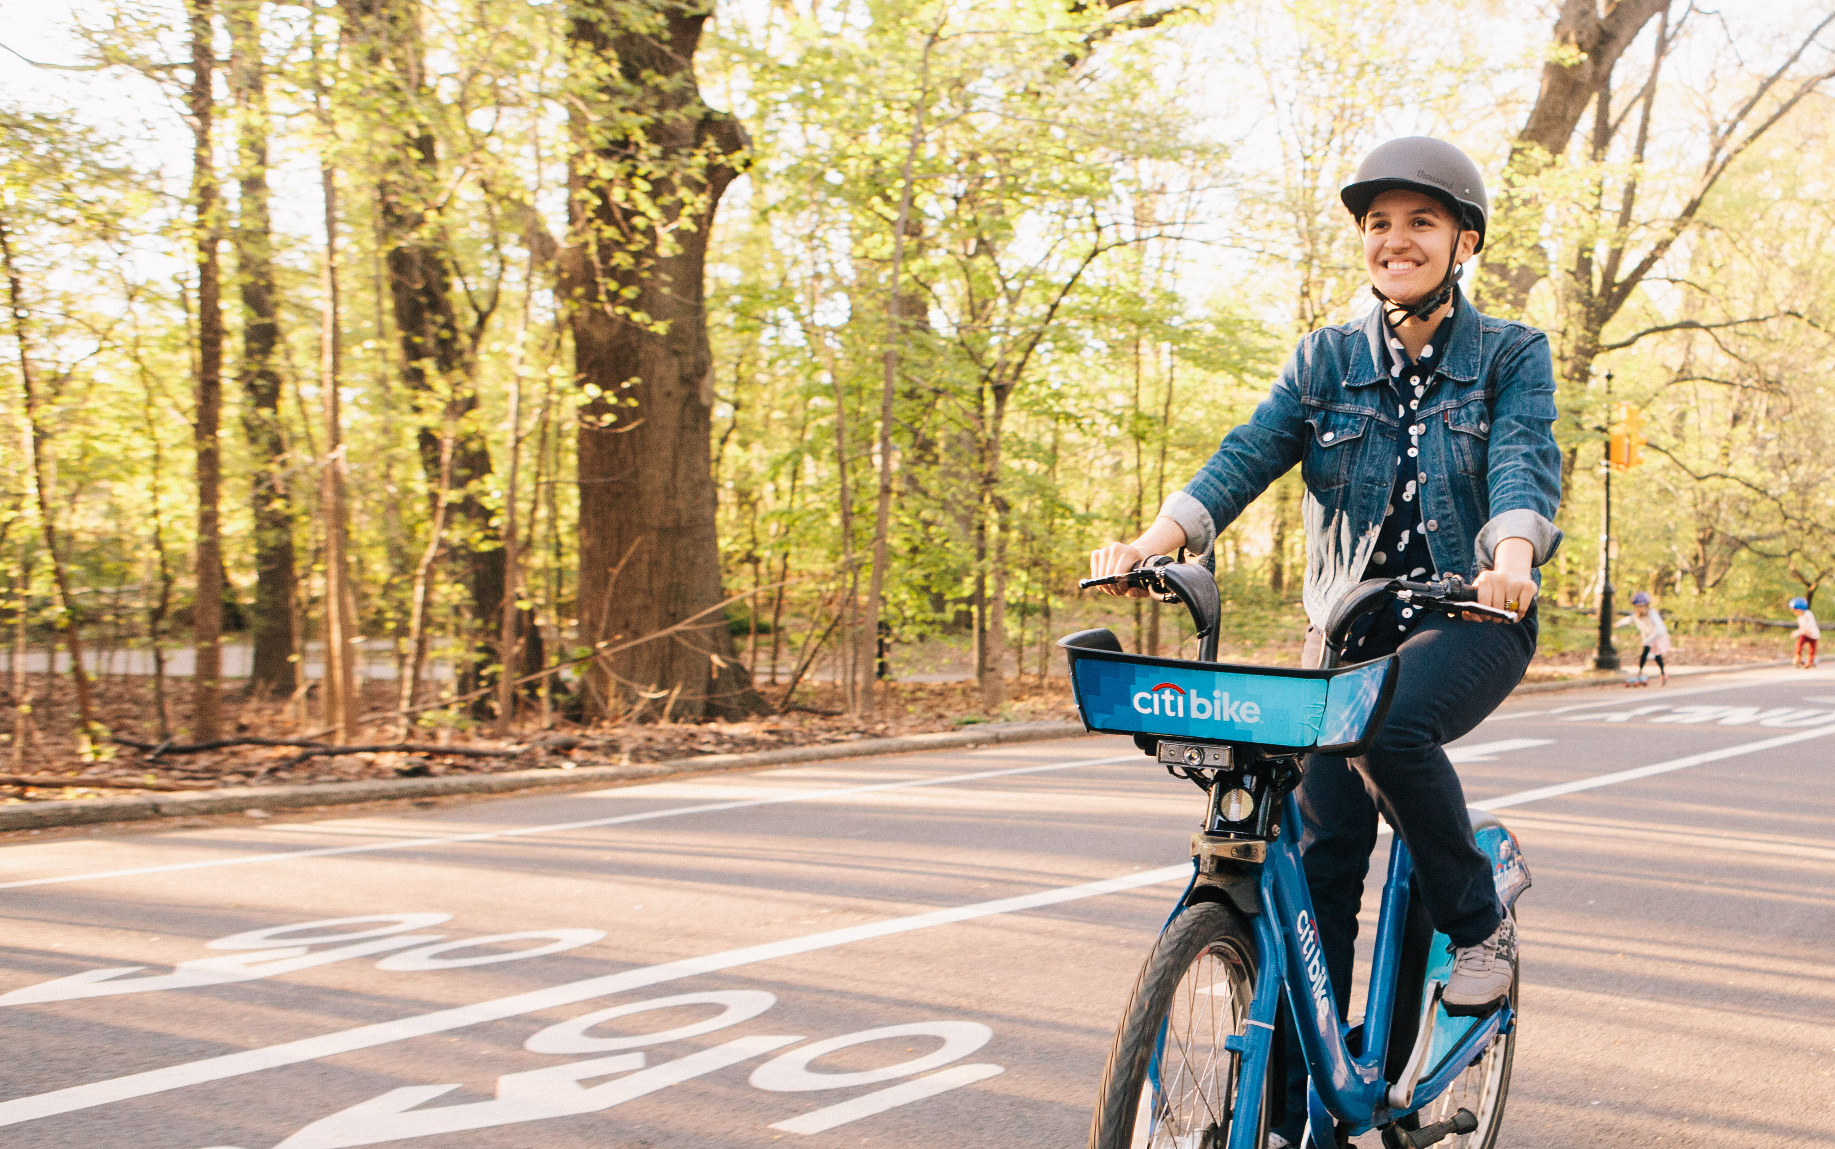
Jersey City, New Jersey
April 2019, Monthly Report

Slide 2

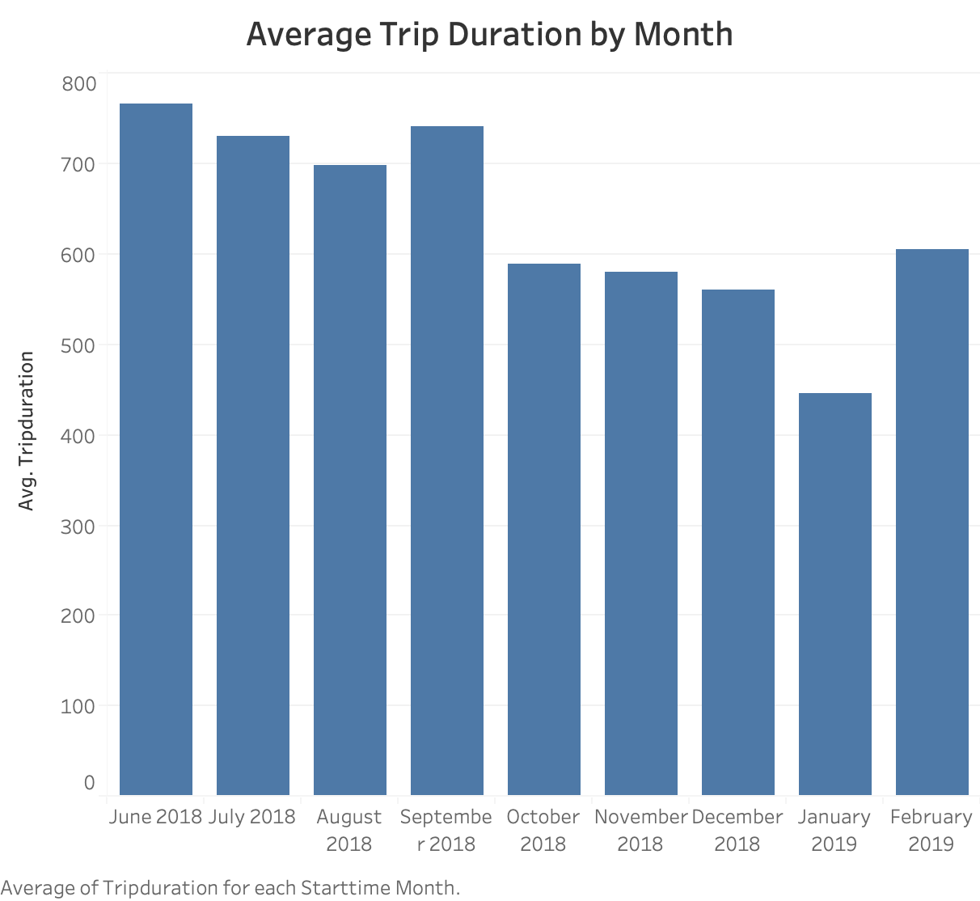
Our Jersey City Riders like to take shorter rides during the coldest months. When Spring has sprung in February, the riders are back in full force.
340k Rides and Counting
(June 2018 – February 2019)

Slide 3

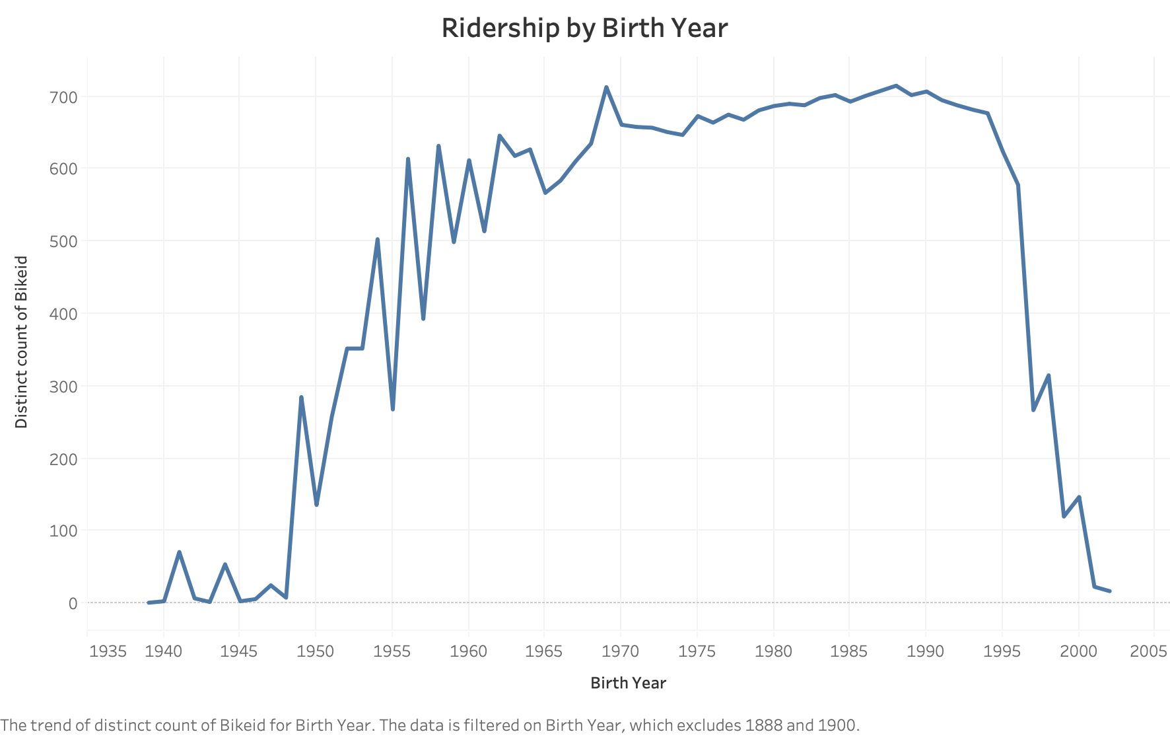
We can see that the workforce that makes up the bulk of the Jersey City bike commuter is evenly split between Millennials and Gen Xers.

Slide 4
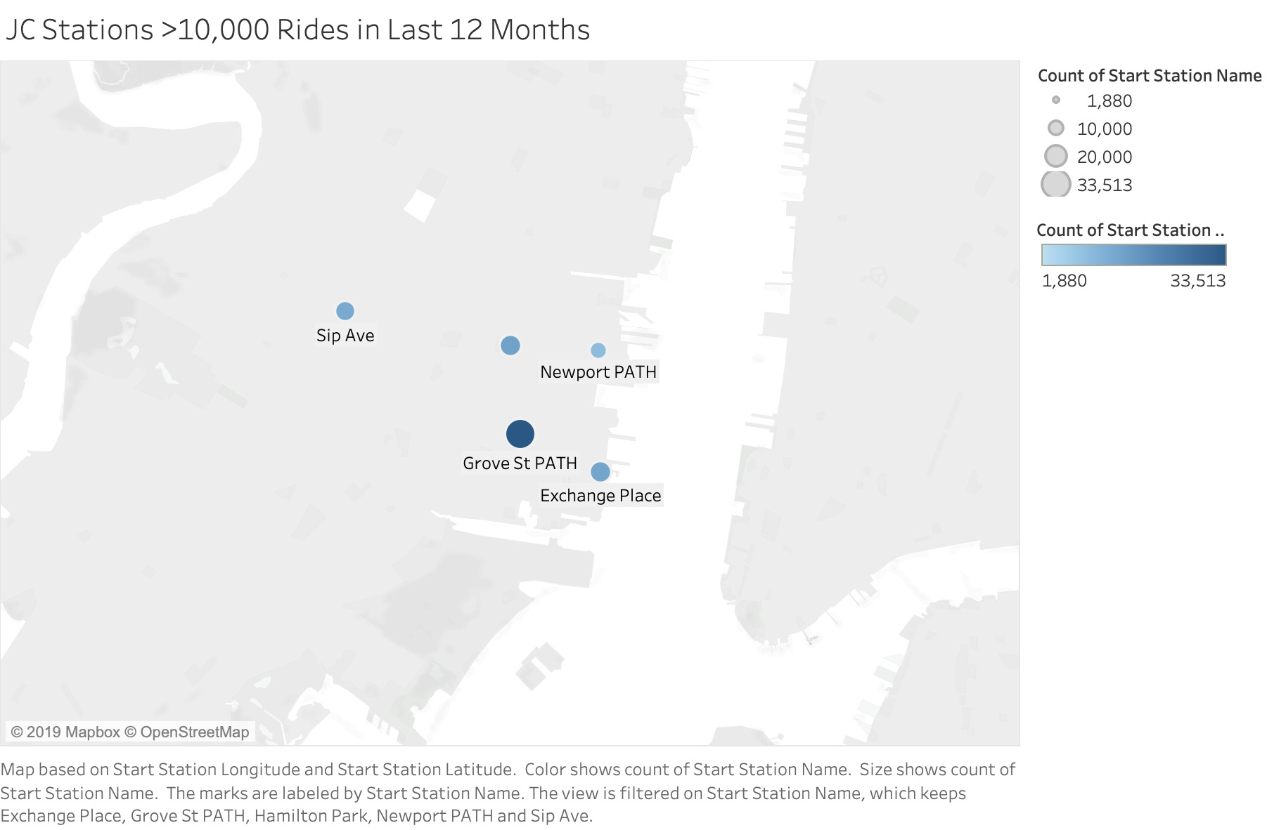


Slide 5
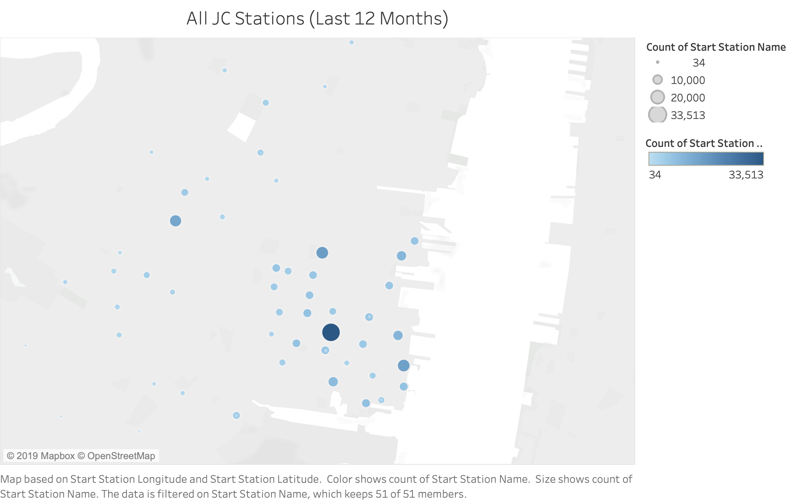

Slide 6
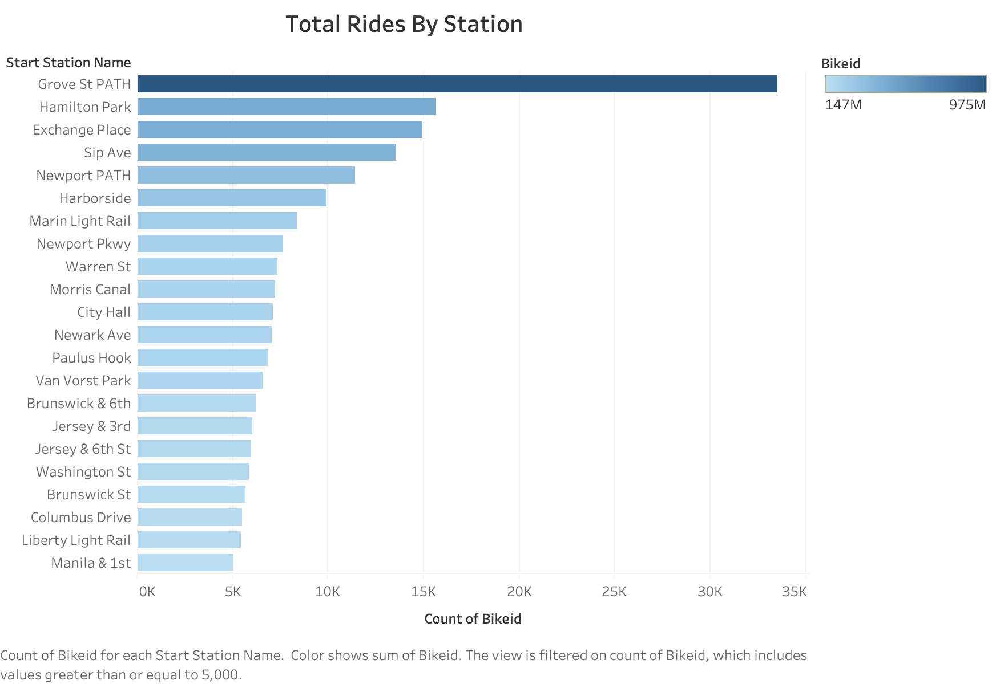
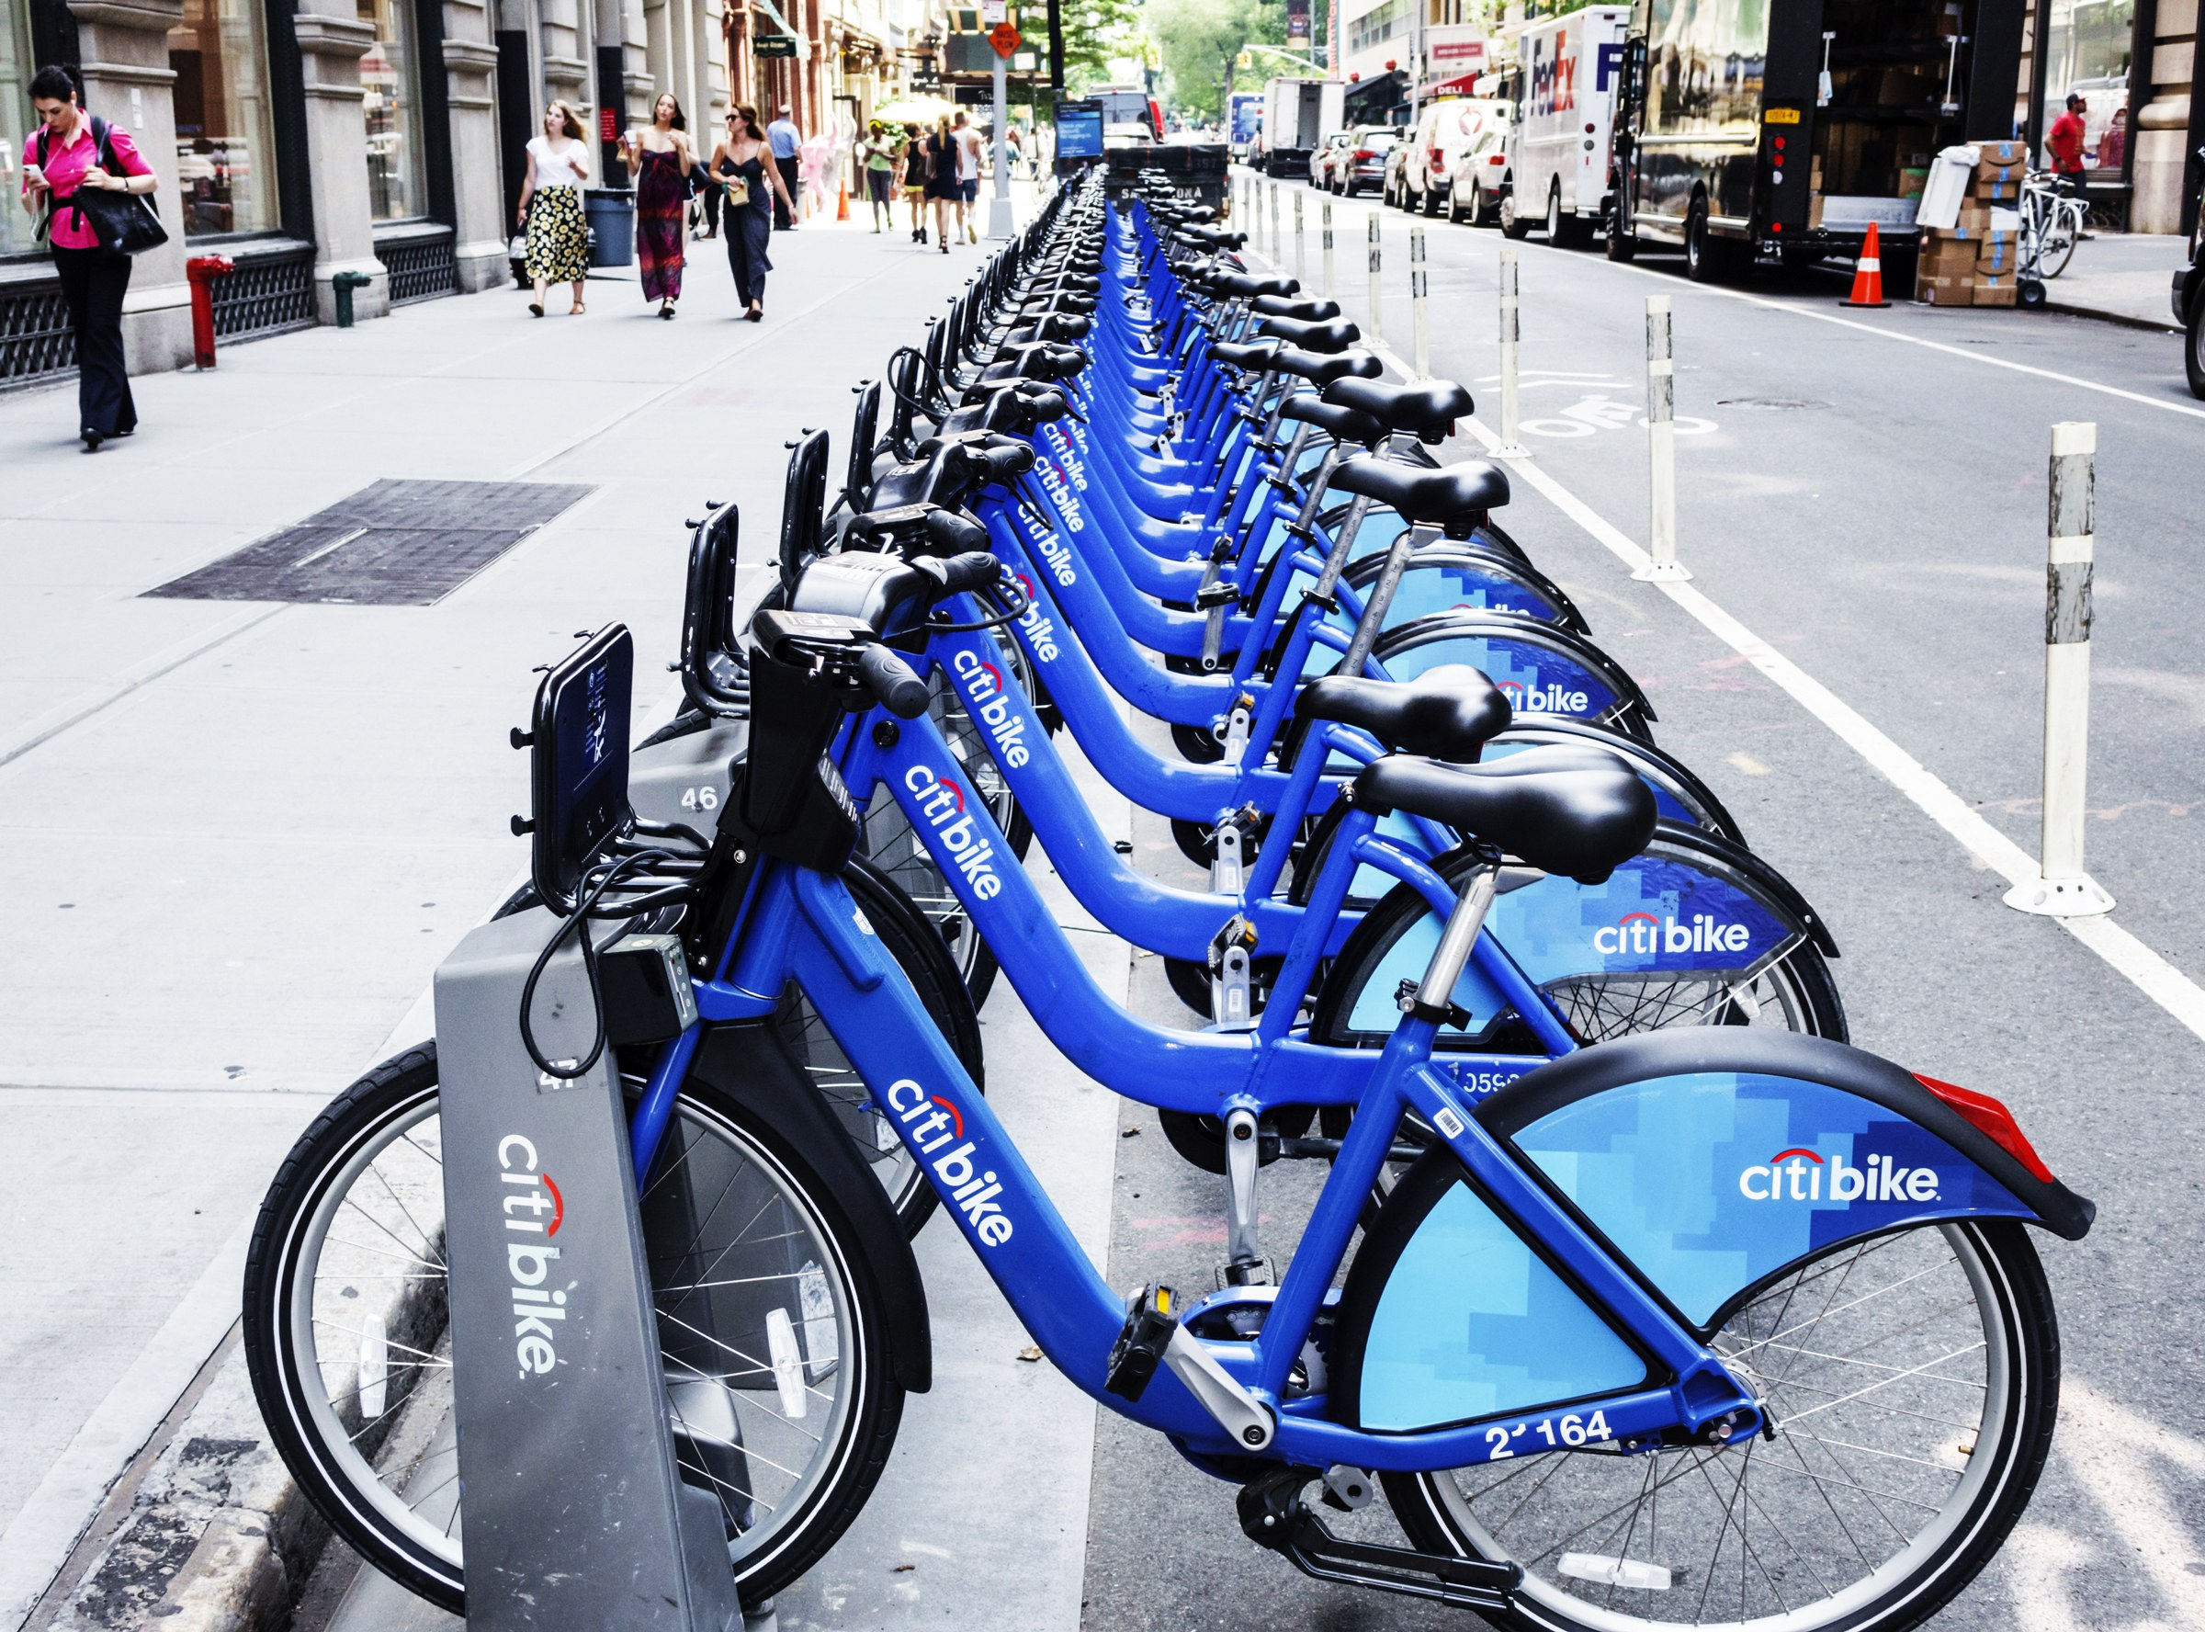
Many of our morning commuters are starting out at Grove Street Path Station. Our research suggests they are taking the path to the Grove Street Station, and work at Exchange Place financial district.

Slide 7
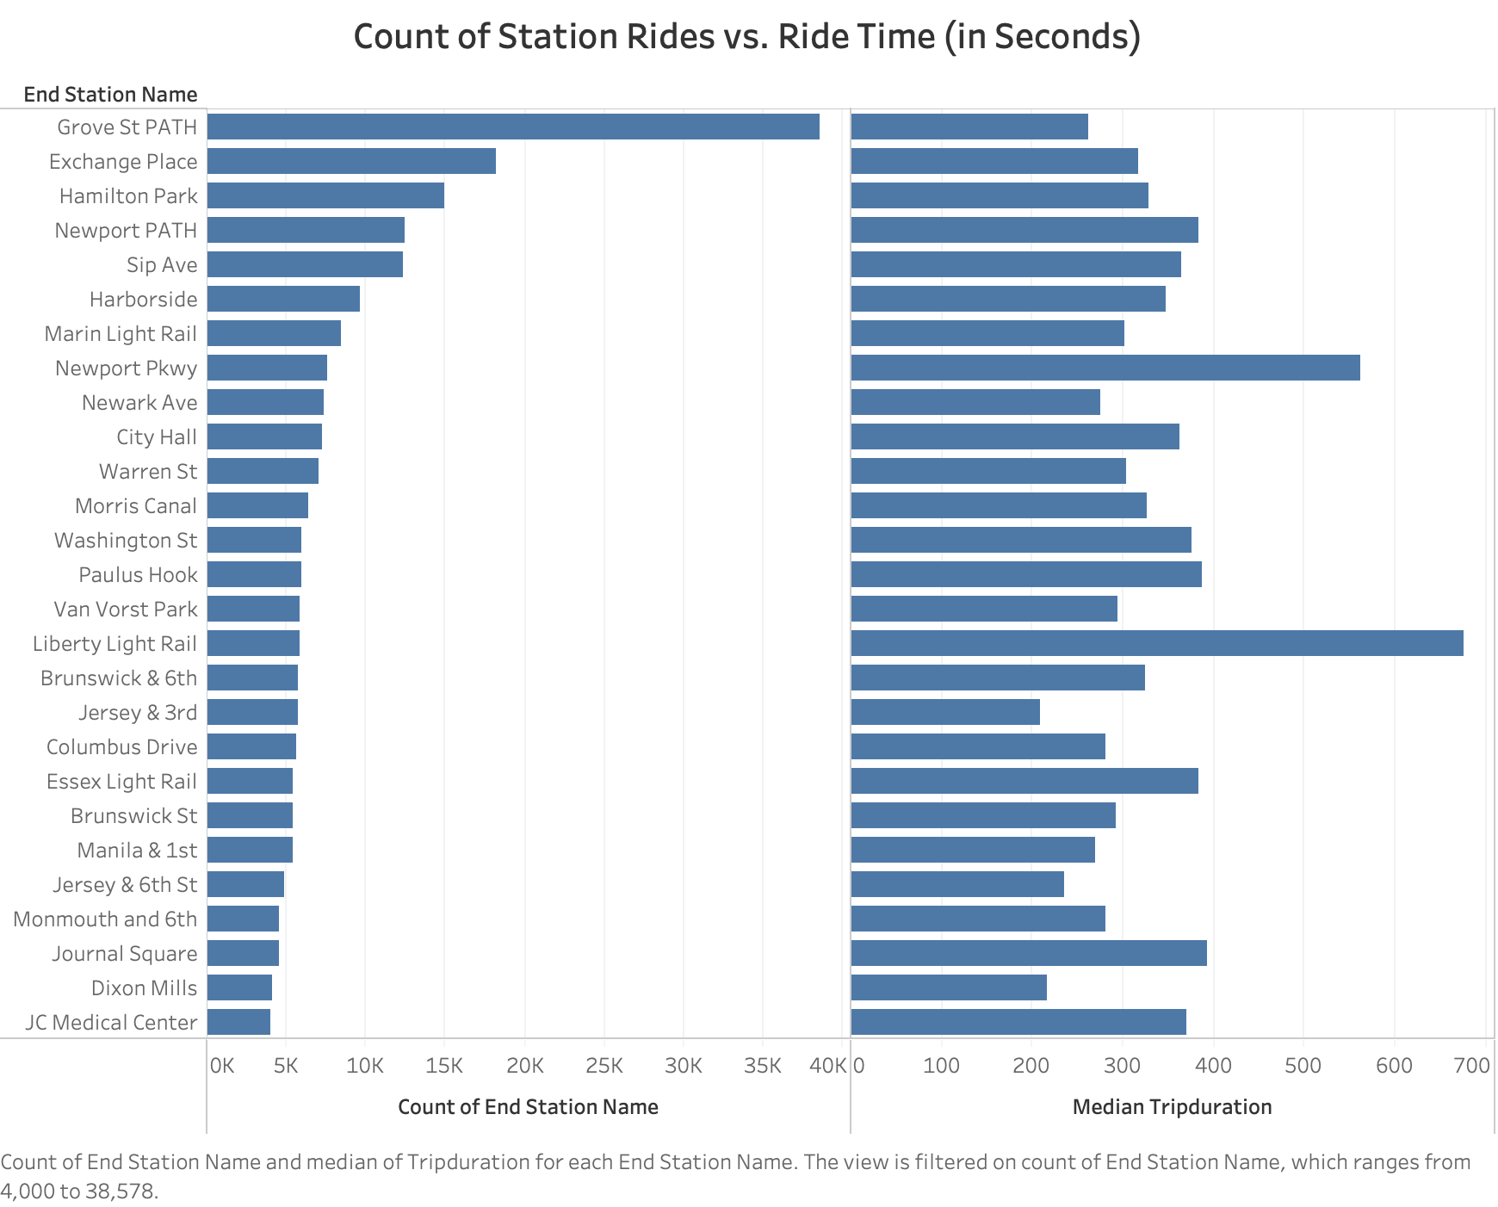
We can see that the most popular stations also have shorter ride times, Grove Street PATH station has a median ride time of 4-5 minutes.
Easier rides to better places mean more riders for CitiBike.

Slide 8
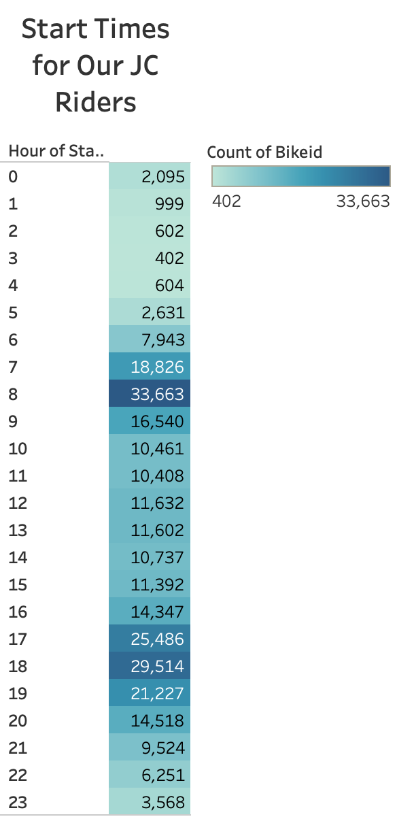
9-5? Nope…
Amongst our morning riders many start those rides at 8 AM and 6 PM suggesting that they are working from 9 – 6pm daily.

Slide 9
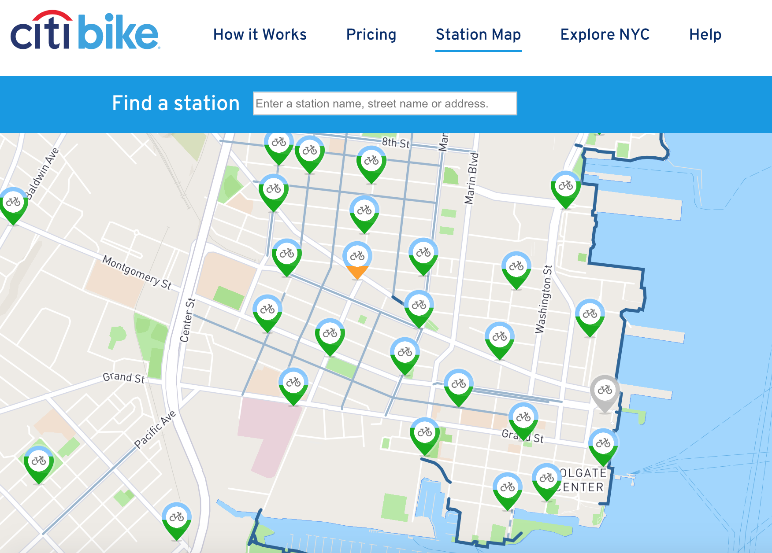
Jersey City is a decent market for CitiBike, with about 720 daily, dedicated riders that make CitiBike work for them.
We learned much about this market and can continue our efforts in similar urban commuter environments in 2020 and beyond.

Slide 10


